Slide 1
Bypass for FCC_ee injector
Bowen

Slide 2
Lattice design of bypass
Dogleg
Chicane

Slide 3
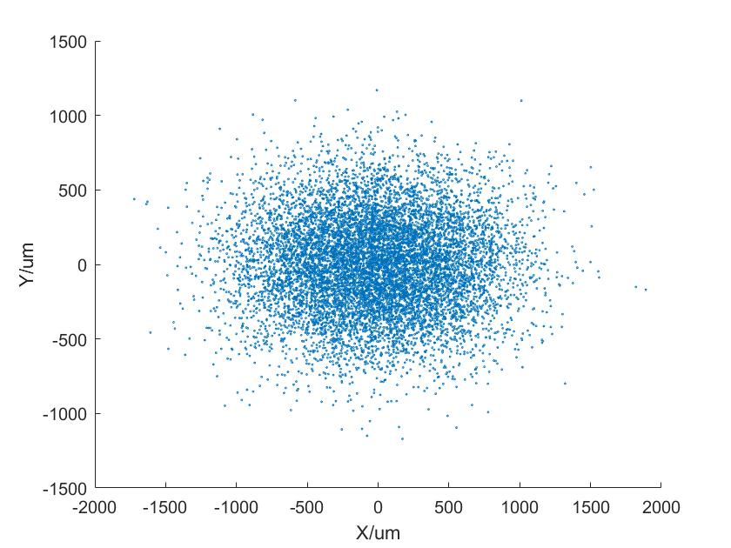
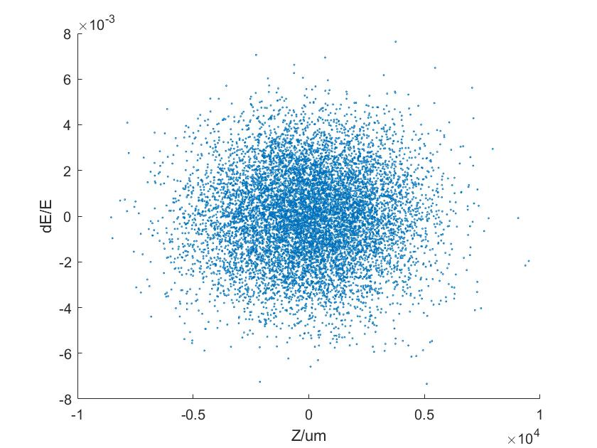
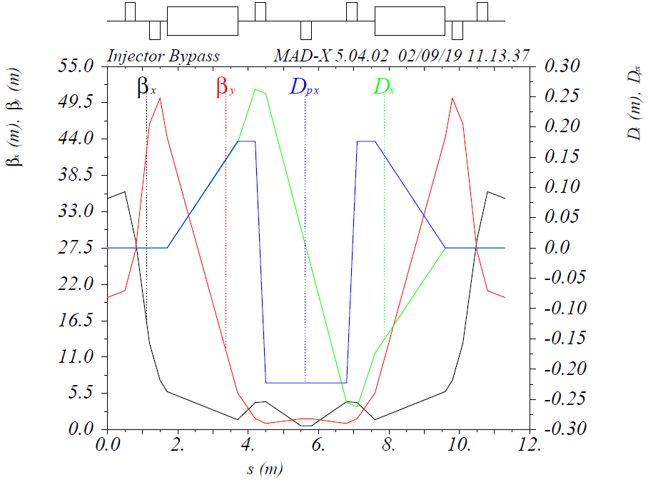
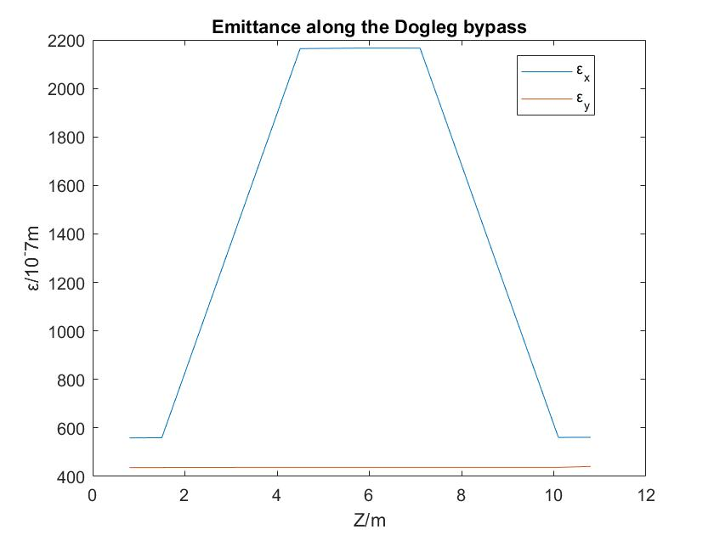
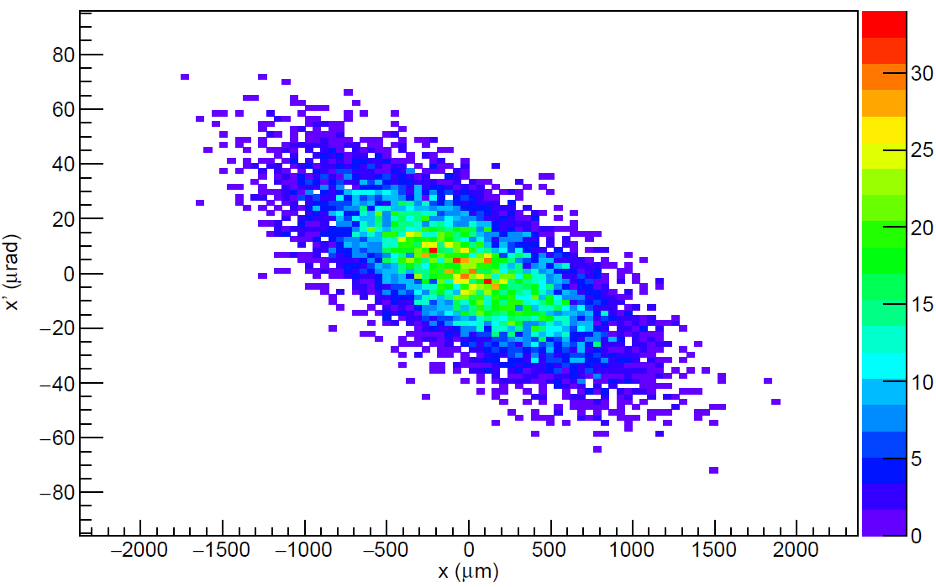
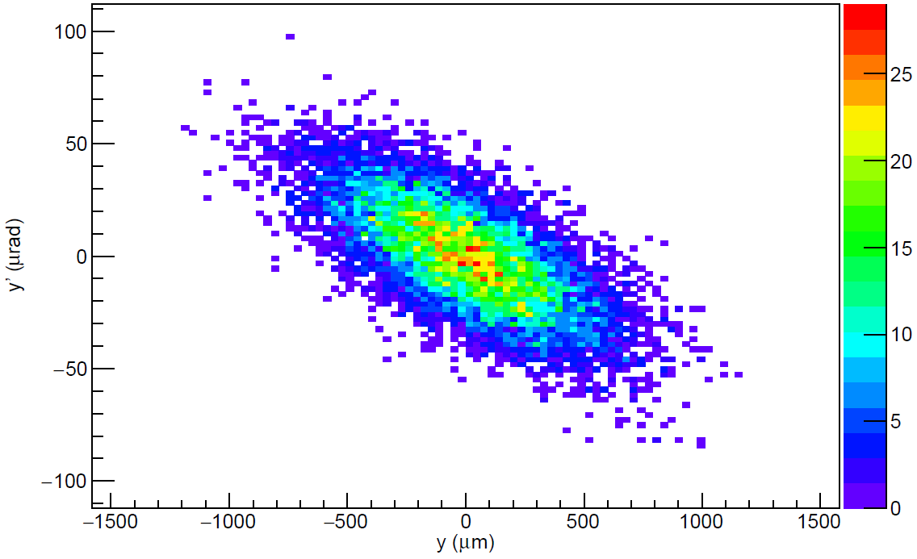
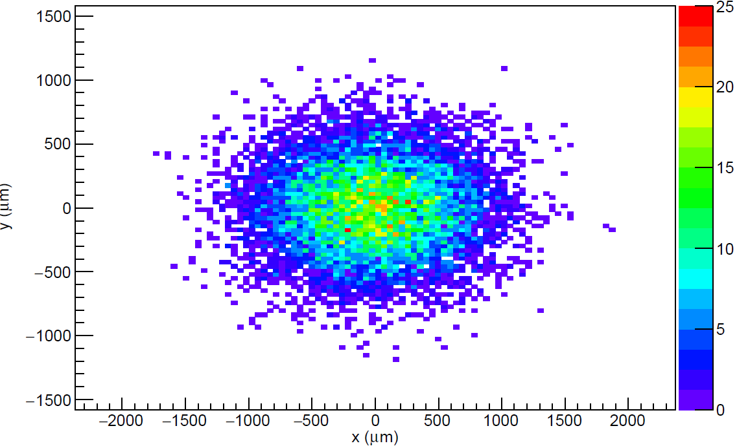
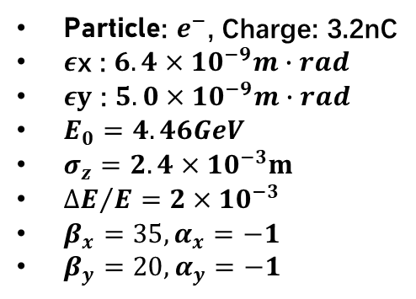
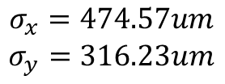
1. Dogleg
PTC_track
Placet
$$σ_{x}=474.57um$$
$$σ_{y}=316.23um$$
Emittance change
longitudinally
Particle: $e^{−}$, Charge: 3.2nC
$ε$x : $6.4×{10}^{−9}m∙rad$
$εy$ : $5.0×{10}^{−9}m∙rad$
$E_{0}=4.46GeV$
$σ_{z}=2.4×{10}^{−3}m$
${∆E}/E=2×{10}^{−3}$
$β_{x}=35, α_{x}=−1$
$β_{y}=20, α_{y}=−1$

Slide 4
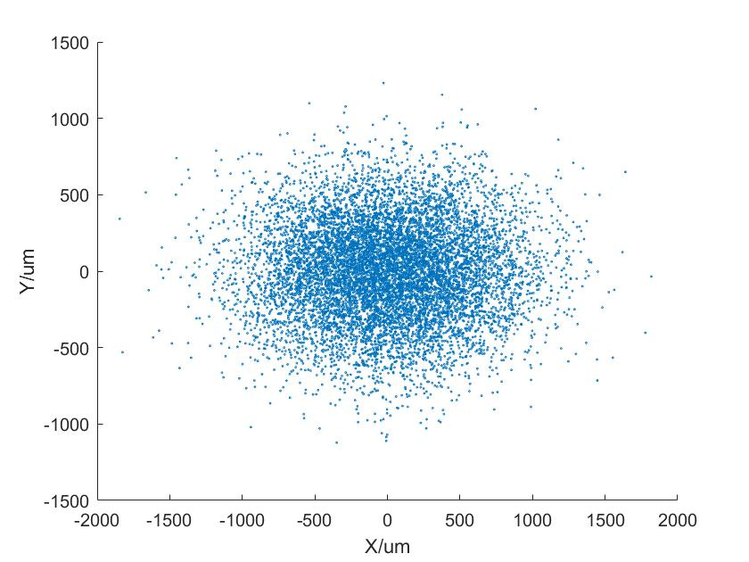
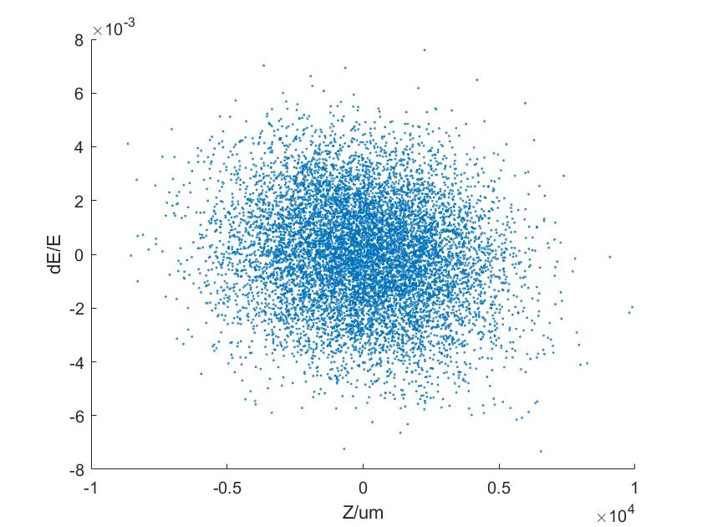
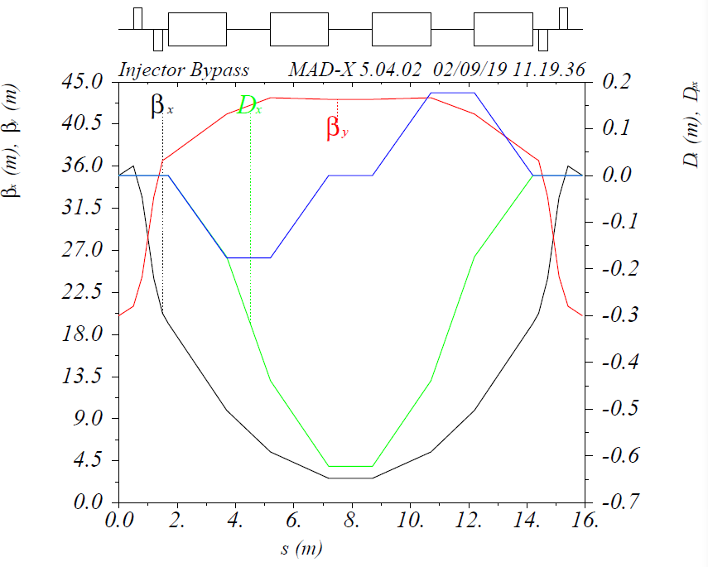
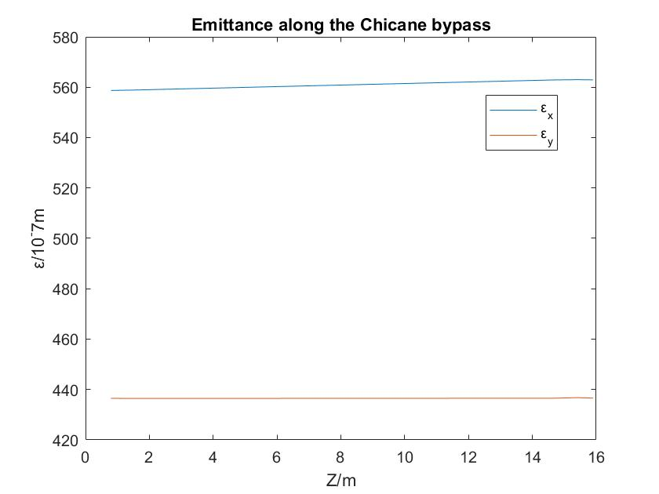
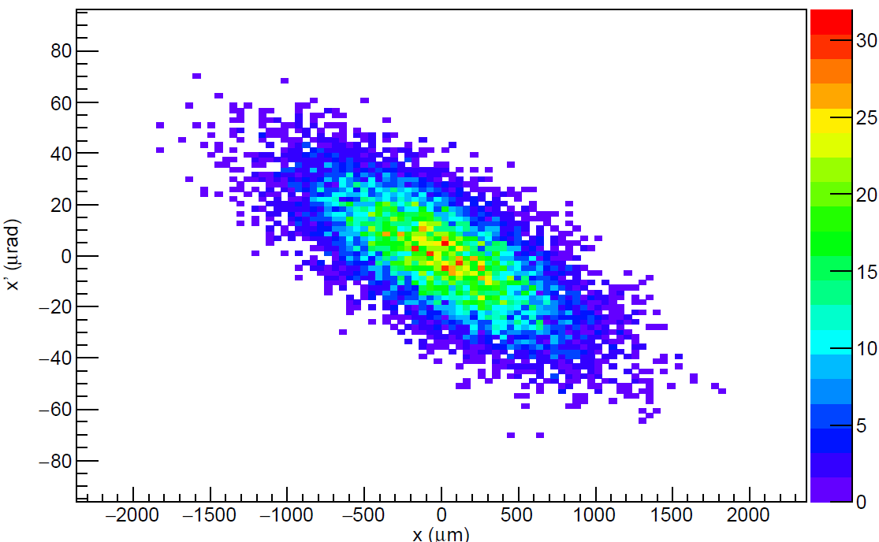

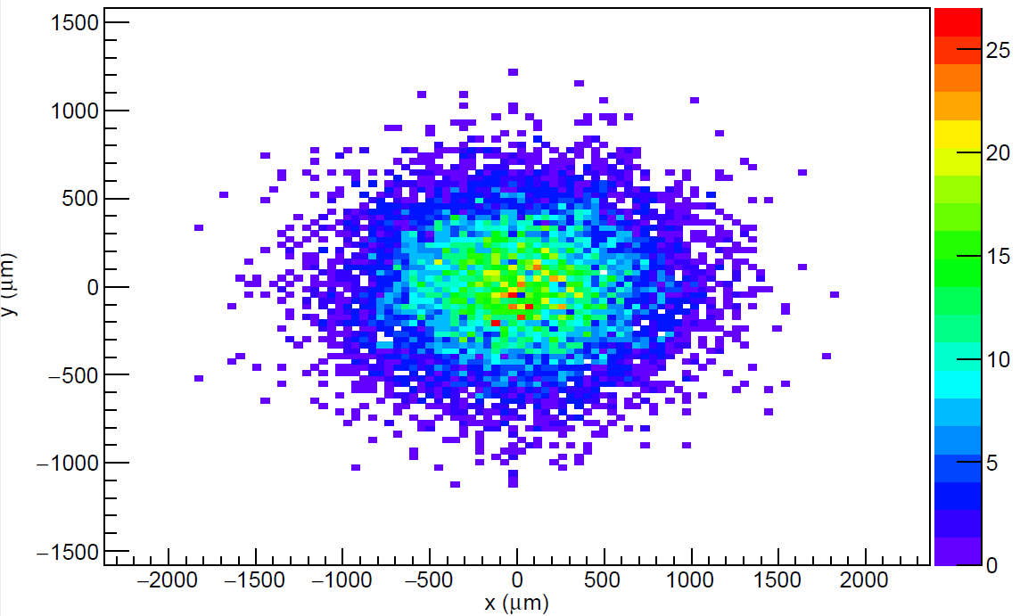
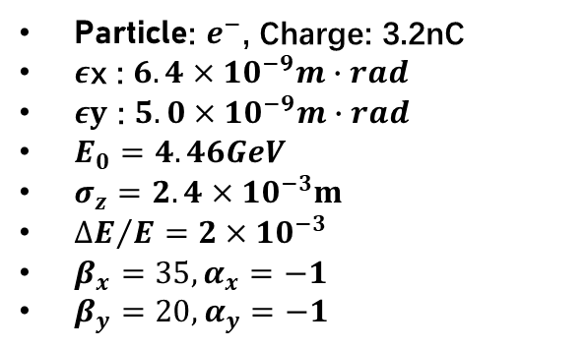
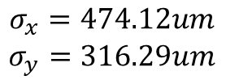
2. Chicane
PTC_track
Placet
$$σ_{x}=474.12um$$
$$σ_{y}=316.29um$$
Emittance change
longitudinally
Particle: $e^{−}$, Charge: 3.2nC
$ε$x : $6.4×{10}^{−9}m∙rad$
$εy$ : $5.0×{10}^{−9}m∙rad$
$E_{0}=4.46GeV$
$σ_{z}=2.4×{10}^{−3}m$
${∆E}/E=2×{10}^{−3}$
$β_{x}=35, α_{x}=−1$
$β_{y}=20, α_{y}=−1$

Slide 5
2019.9.10 short meeting
Positron source
Superkekb
7GeV 2nC 50Hz
Comparation between CEPC (/SuperKEKB) and FCC
Consideration about RF pulse, beam bunch and magnetic field (see Oide’s slides)

Slide 6
16/09—22/09
FCC SAD code reading
Salim’s thesis reading

Slide 7
FCC-ee injector linac
0 - 1.54 GeV;
1.54 GeV - 6 GeV
1.54 GeV - 4.46 GeV;
4.46 GeV – 6 GeV

Slide 8
0 - 1.54 GeV
Length = 81.257m
E = 0.012GeV → 1.567GeV
Momentum spread: Δp/p = 1e-6 (X)
Initial EMITX = 3.5e-7m, EMITY = 5e-7m
Final EMITX = 2.7e-9m (8.3e-9?), EMITY = 3.8e-9m (4.3e-9?)
Dispersion_X = 8e-4, Dispersion_Y = 2.1e-4

Slide 9
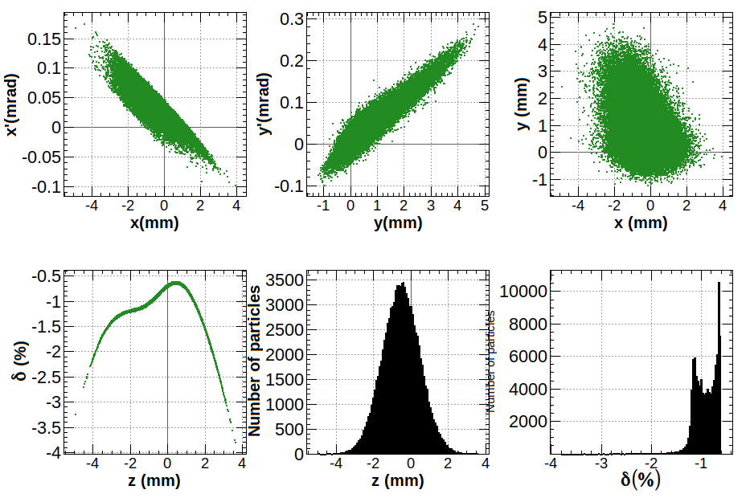
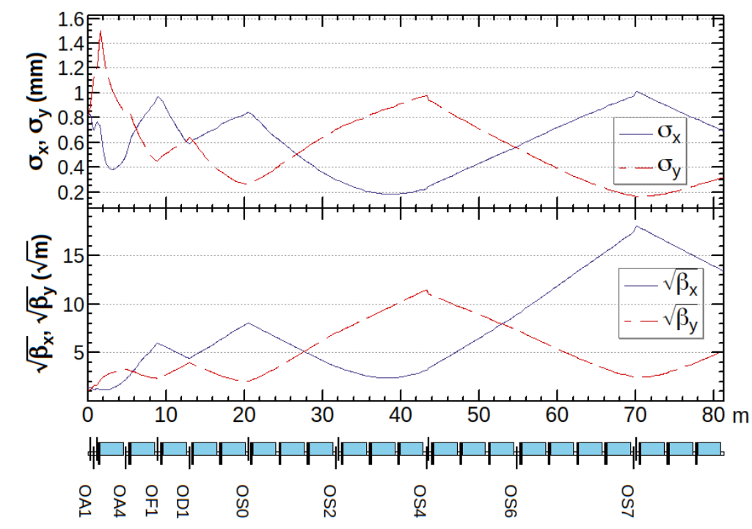

Slide 10
1.54 GeV - 6 GeV
Length = 248.497m
E = 1.54GeV → 6.14069GeV
Momentum spread: δP/P = 2.0e-8 (Χ)
Initial EMITX = 2.0e-9m, EMITY = 2.0e-9m
Final EMITX = 5.0e-10m (5.188e-9?), EMITY = 5.0e-10m (1.796e-9?)
Dispersion_X = 3.10e-4, Dispersion_Y = 5.10e-4

Slide 11
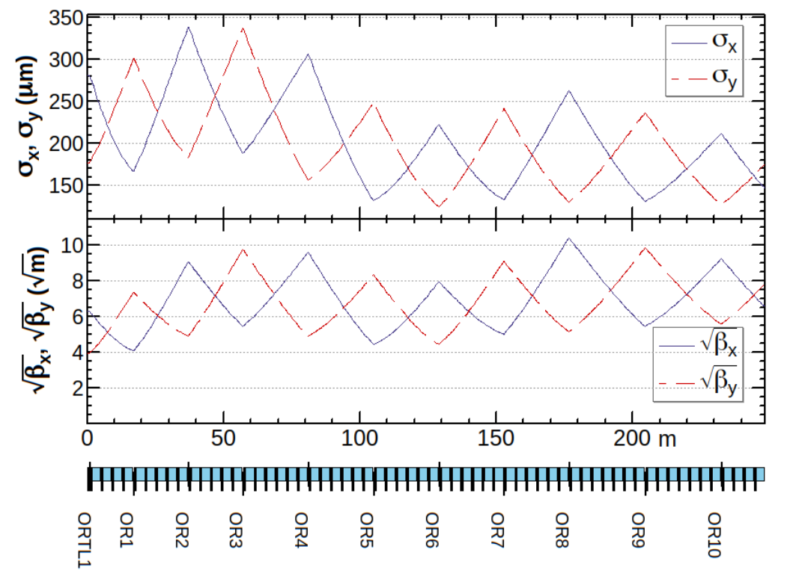
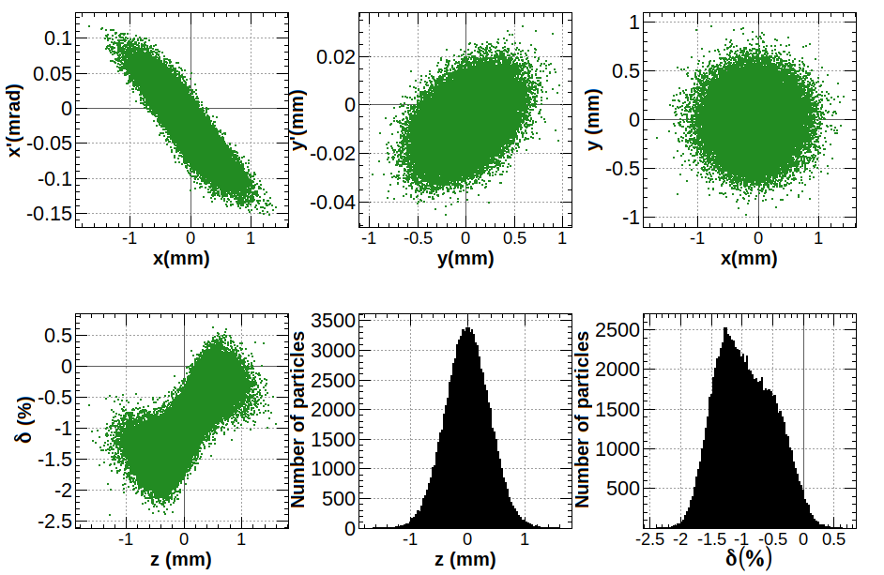

Slide 12
1.54 GeV - 4.46 GeV
Length = 160.916m
E = 1.54GeV → 4.51GeV
Momentum spread: δP/P = 1.6e-8 (X)
Initial EMITX = 2.0e-9m, EMITY = 2.0e-9m
Final EMITX = 7.0e-10m (1.2e-8?), EMITY = 7.0e-10m (3.7e-9?)
Dispersion_X = 2.5e-4, Dispersion_Y = 1.7e-4

Slide 13
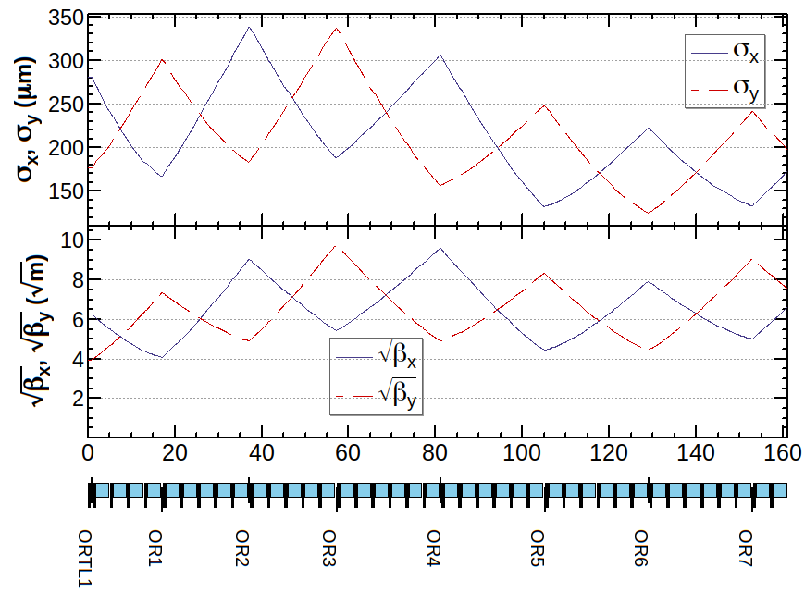
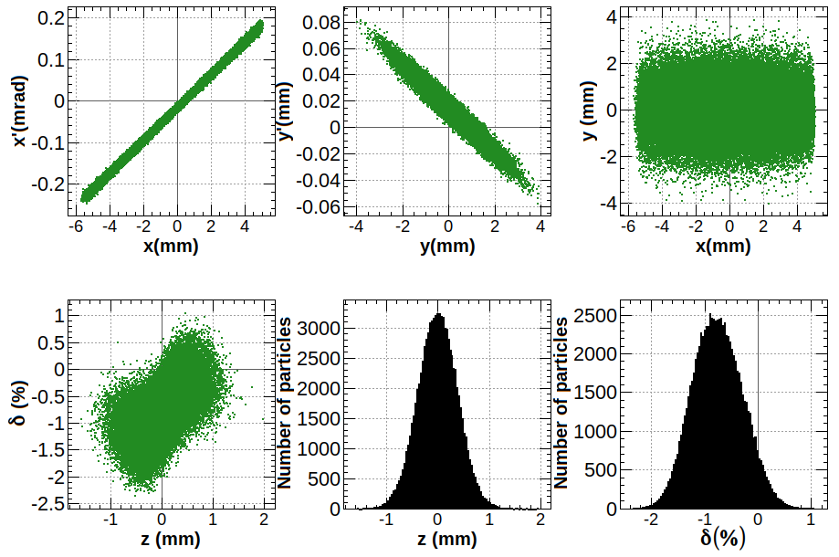
αx = -1.4685, αy = 1.3642, βx = 44.2332, βy = 56.9306
εx = 7.0e-10m, εy = 7.0e-10m
dx = 2.5e-4, dy = 1.7e-4

Slide 14
4.46 GeV – 6 GeV
Later

Slide 15
Further simulation
Without considering wakefields and misalignments
Try to get particle distribution zout[] and calculate again to see the emittance and energy spread

Slide 16
0 - 1.54 GeV
Length = 81.257m
E = 0.012GeV → 1.571GeV
Cavity phase: -90°
Momentum spread: 5% → 1%
Initial EMITX = 3.5e-7m, EMITY = 5e-7m
Final EMITX = 2.7e-9m (2.845e-9), EMITY = 3.8e-9m (4.187e-9)

Slide 17
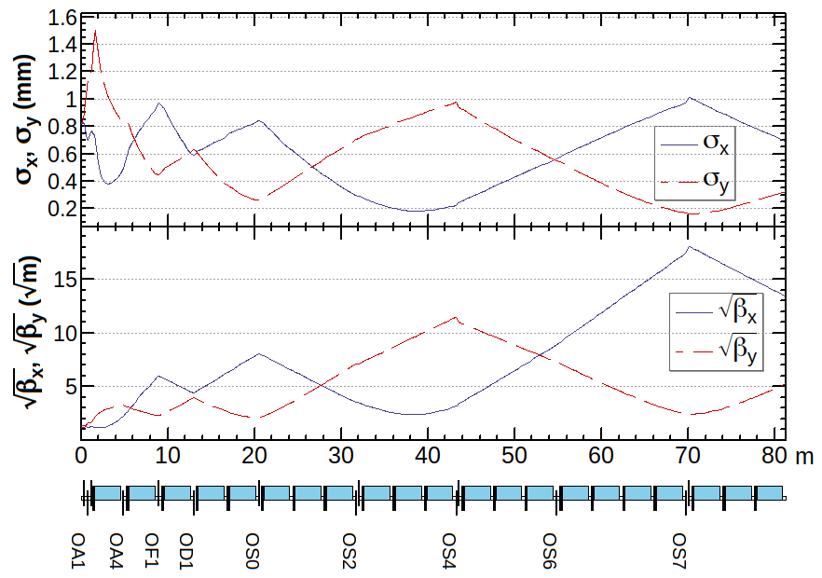
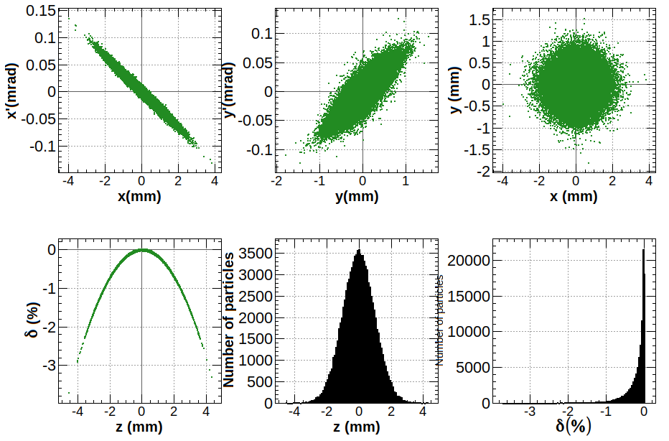
αx = 5.658, αy = -1.920,
βx = 179.346, βy = 27.857, εx = 2.7e-9m, εy = 3.8e-9m
δE = 1%, σz : 1mm → 0.8mm , σx = 0.696mm, σy = 0.325mm

Slide 18
1.54 GeV - 6 GeV
Length = 248.4973m
E = 1.54GeV → 6.1435GeV
Cavity phase: -90°
Momentum spread: 2.4% → 1%
Initial EMITX = 2e-9m, EMITY = 2e-9m
Final EMITX = 5e-10m (5.02e-10), EMITY = 5e-10m (5.01e-10)

Slide 19
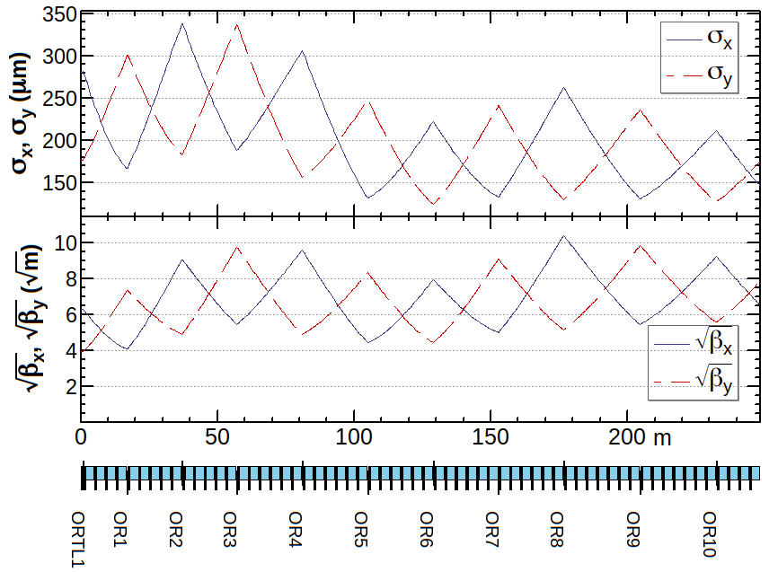
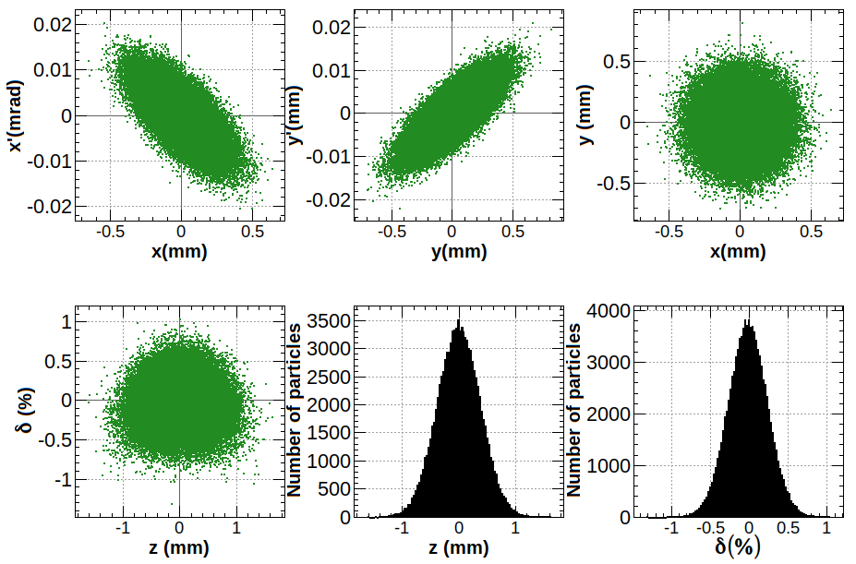
αx = 0.967, αy = -1.297,
βx = 42.782, βy = 61.439, εx = 5e-10m, εy = 5e-10m
δE = 1%, σz : 0.38mm , σx = 146.26um, σy =175.27 um

Slide 20
1.54 GeV - 4.46 GeV
Length = 160.916m
E = 1.54GeV → 4.51GeV
Cavity phase: -90°
Momentum spread: 2.4% → 1%
Initial EMITX = 2e-9m, EMITY = 2e-9m
Final EMITX = 7e-10m (6.84e-10), EMITY = 7e-10m (6.82e-10)

Slide 21
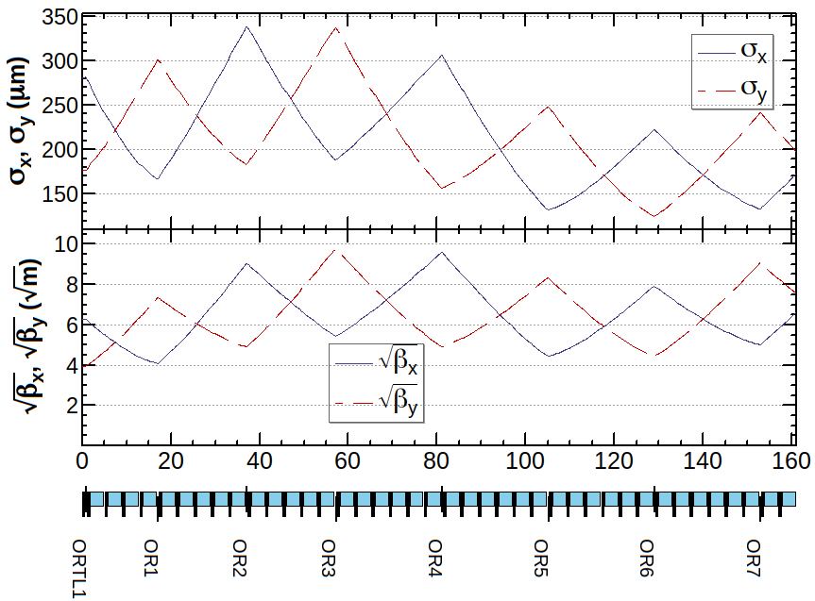
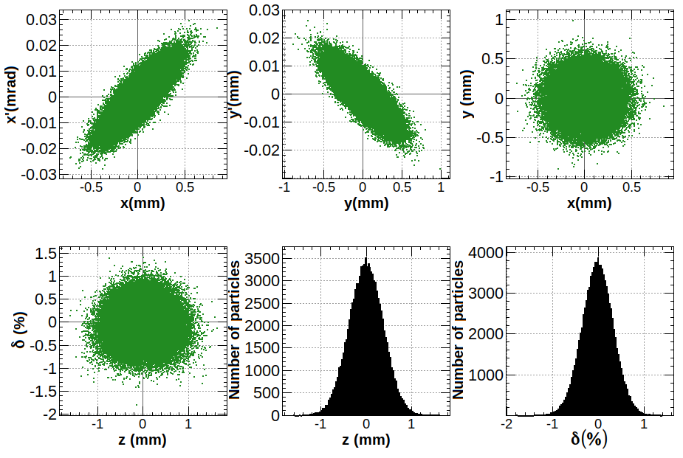
αx = -1.468, αy = 1.364,
βx = 44.233, βy = 56.930, εx = 7e-10m, εy = 7e-10m
δE = 1%, σz : 0.4mm → 0.38mm , σx = 175.96um, σy = 199.63mm

Slide 22

Further simulation
In previous simulation of ideal conditions, the decrease of the beam size σz is due to the definition of his original code. (too many confused definitions)
MARK: IP(SIGZ, DP), (* Beam parameters *) SIGZ , DP
Consider the difference of z-δp between 0-1.54 and 1.54-6
Consider simulation with wakefield
Compare SuperKEKB simulation

Slide 23
Consider the difference of z-δp between 0-1.54 and 1.54-6
Due to the energy spread, chromaticity will come out by quadrupoles, and then the longitudinal emittance will increase.
In 1.54-6, Salim still used ideal energy distribution for the beam, and the most important, the emittance is incorrect. It’s wrong for the design. The real beam is from 0-1.54.
Use output of 0-1.54 as the input of 1.54-4.46, 6GeV with wakefield

Slide 24
0 – 1.54GeV, no wakefield
αx = 5.658, αy = -1.920, βx = 179.346, βy = 27.857,
εx = 2.7e-9m (2.8e-9m), εy = 3.8e-9m (4.2e-9m), σx = 0.696 (0.707)mm, σy = 0.325 (0.323)mm
E = 1.571GeV, δE = 0.25%, σz : 1mm

Slide 25
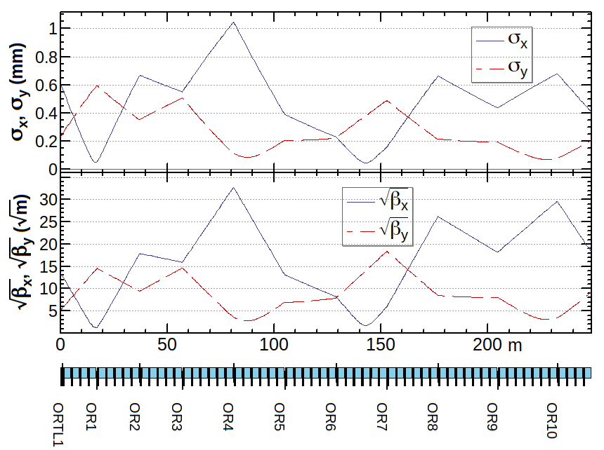
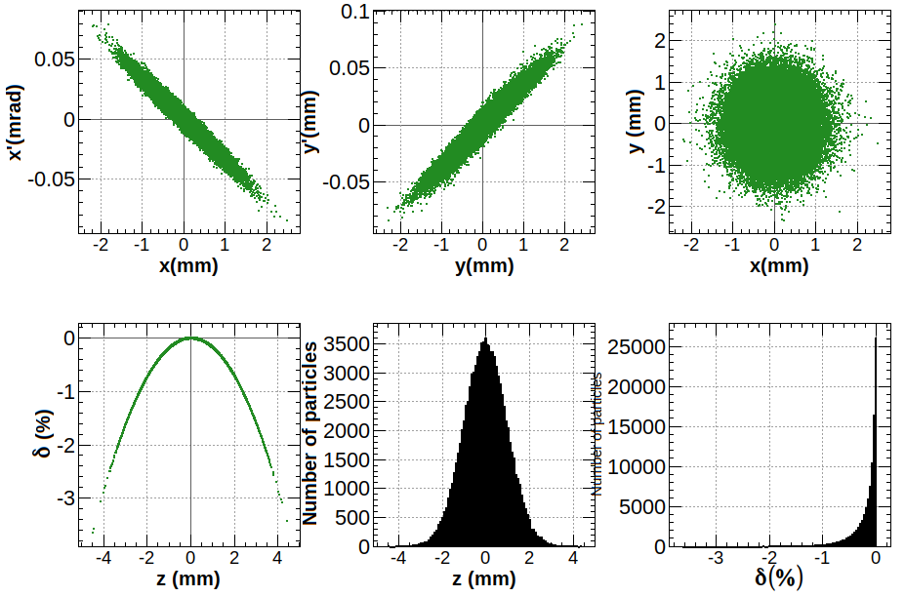
1.54 - 6GeV, no wakefield
αx = 13.01, αy = -3.58, βx = 331.07, βy = 85.07,
εx = 1.51e-9m, εy = 2.22e-9m, σx = 0.454mm, σy = 0.530mm
E = 6.14GeV, δE = 0.25%, σz : 1mm

Slide 26
Optics 需要重新匹配， 1.5-6GeV 发射度对不上，怀疑是optics没匹配好，导致发射度增长(不清楚SAD模拟的正确与否)

Slide 27
算的1.54GeV束流动力学，αx,αy分别为-2，2，得到较好的束流分布；后面加一些磁铁连接1.54-6GeV，保证在进入后面的linac后，α为0。进入第二段的模拟，选择前一段模拟α为0的最终结果作为初始束流(但是要保证此时的束流为匹配好的束流)。

Slide 28
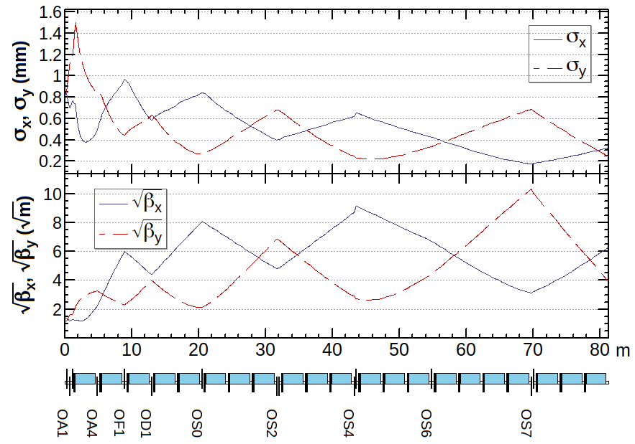
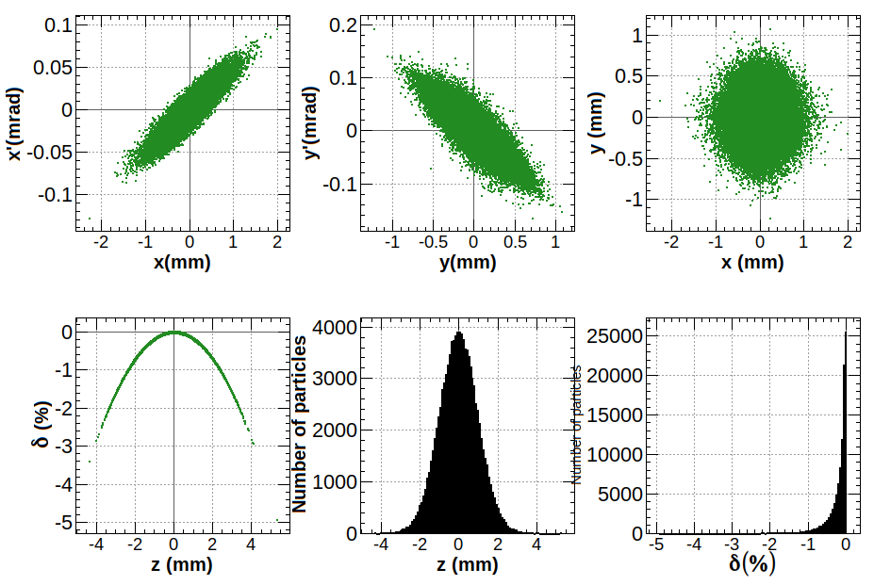
0 – 1.54GeV, no wakefield
αx = -2, αy = 2, βx = 39.52, βy = 15.56,
εx = 2.7e-9m (2.8e-9m), εy = 3.8e-9m (4.2e-9m), σx = 0.327 (0.339)mm, σy = 0.243 (0.240)mm
E = 1.571GeV, δE = 0.25%, σz : 1mm

Slide 29
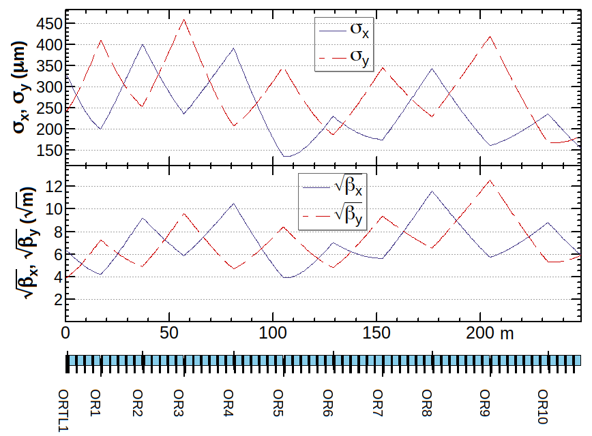
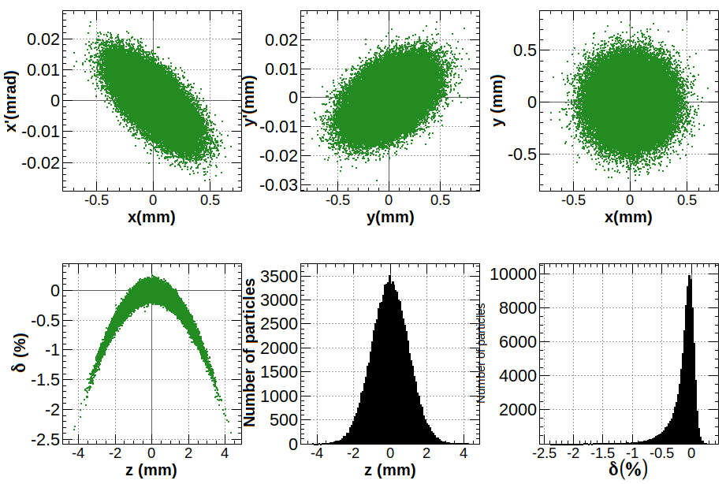
1.54 - 6GeV, no wakefield
αx = 0.912, αy = -0.499, βx = 35, βy = 35,
εx = 7e-10 (6.88e-10 )m, εy = 1e-9 (9.66e-10 ) m, σx = 156.52(155.64 ) um, σy =187.08 (183.83)um
E = 6.17GeV, δE = 0.198%, σz : 1mm

Slide 30
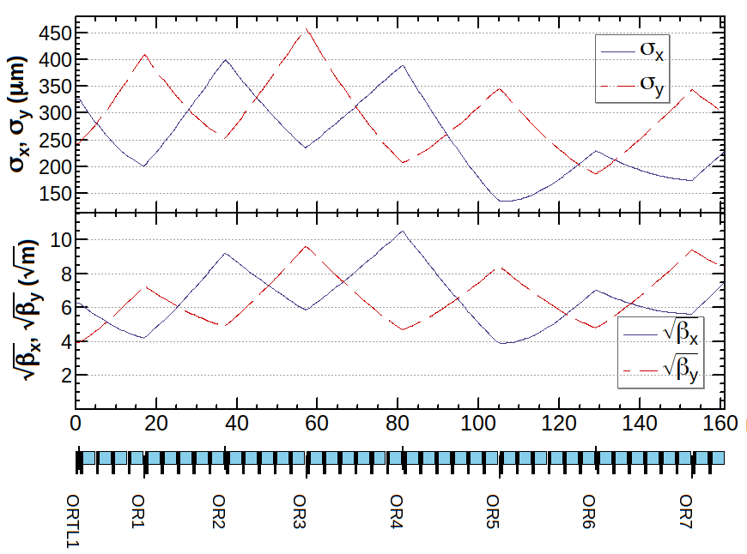
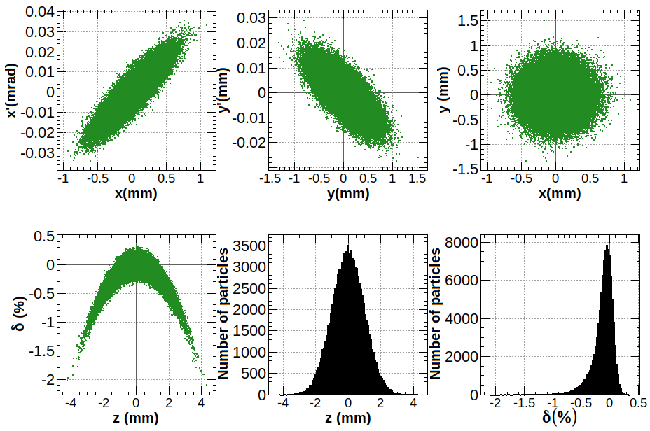
1.54 – 4.46GeV, no wakefield
αx = -1.86, αy = 1.066, βx = 56.77, βy = 68.71,
εx = 9e-10 (9.24e-10 )m, εy = 1.3e-9 (1.30e-9) m, σx = 226.04(228.20) um, σy =298.87 (298.20)um
E = 4.51GeV, δE = 0.186%, σz : 1mm

Slide 31
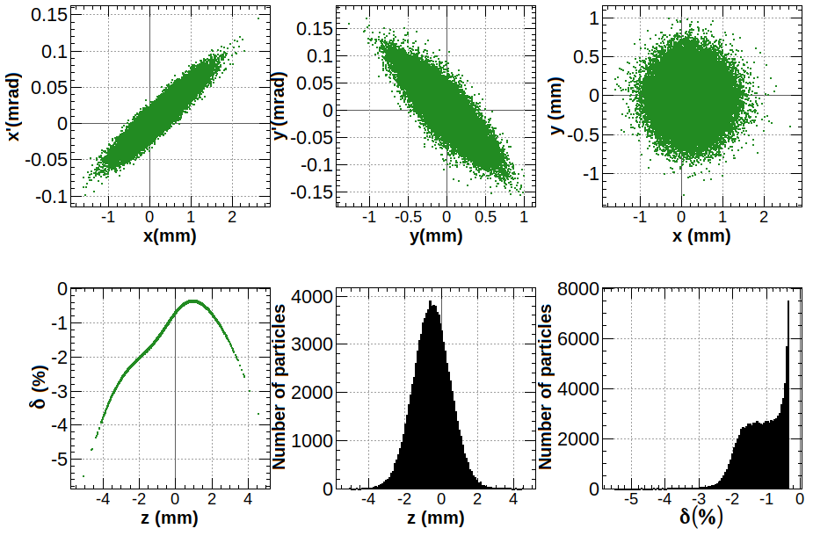
0 – 1.54GeV, with wakefield
αx = -2, αy = 2, βx = 39.52, βy = 15.56,
εx = 2.7e-9m (2.95e-9m), εy = 3.8e-9m (4.33e-9m), σx = 0.327 (0.356)mm, σy = 0.243 (0.249)mm
E = 1.571GeV, δE = 0.578%, σz : 1mm

Slide 32
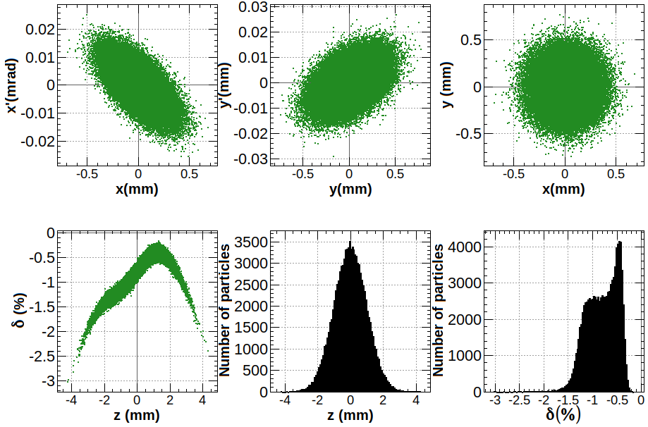
1.54 - 6GeV, with wakefield
αx = 0.912, αy = -0.499, βx = 35, βy = 35,
εx = 7e-10 (6.88e-10 )m, εy = 1e-9 (9.66e-10 ) m, σx = 156.52(155.64 ) um, σy =187.08 (183.83)um
E = 6.17GeV, δE = 0.31%, σz : 1mm

Slide 33
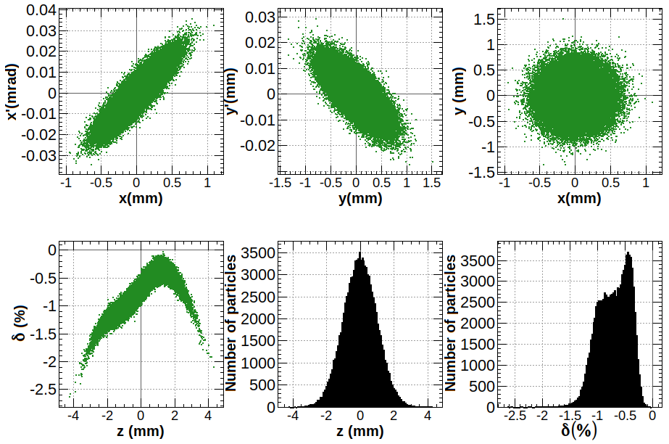
1.54 – 4.46GeV, with wakefield
αx = -1.86, αy = 1.066, βx = 56.77, βy = 68.71,
εx = 9e-10 (9.24e-10 )m, εy = 1.3e-9 (1.30e-9) m, σx = 226.04(229.57) um, σy =298.87 (299.44)um
E = 4.51GeV, δE = 0.286%, σz : 1mm

Slide 34
29号总结
联系salim没有收到关于其code的任何回复
跟师兄交流，支持暂时在1.54GeV加段FODO结构做进一步匹配的决定，保证进入后续的1.54-6GeV加速段的束流α=0，而非1.54GeV出来后的αx=-2, αy=2.
找到解决办法。把1.54GeV输出的zout重新定义，在0-1.54计算完成后在shell内输出zout[[1]]，得到200，根据SAD的定义实际应为1，将其改为1：zout[[1]]=1，再利用OpenWrite, Write等输出，将输出结果代入到1.54-6即可。不过后续的1.54-6加速段的optics需要重新匹配，因为1.54输出的zout中αx=-2，αy=2。
考虑重新匹配1.54-6GeV段的optics

Slide 35
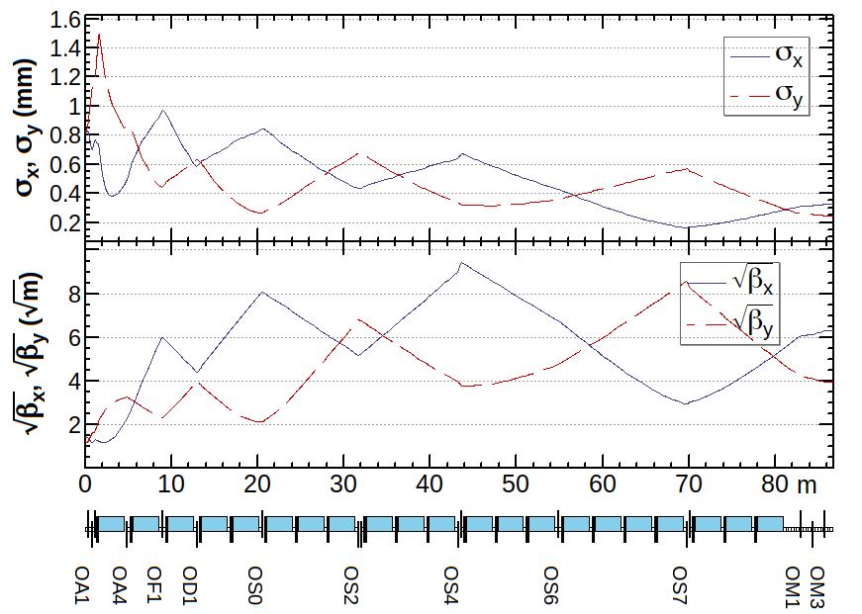
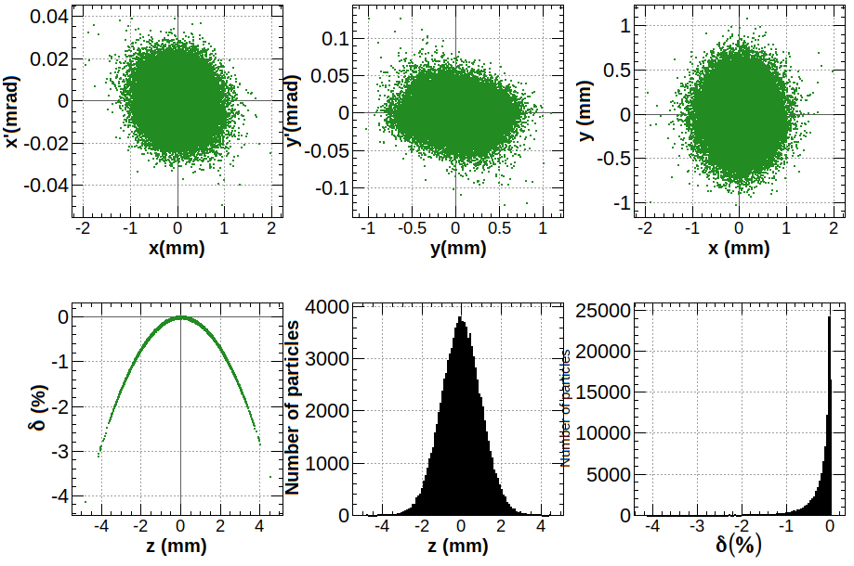
0 – 1.54GeV, no wakefield
αx = -2e-6, αy = 2e-6, βx = 39.52, βy = 15.56,
εx = 2.7e-9m (2.8e-9m), εy = 3.8e-9m (4.2e-9m), σx = 0.327 (0.334)mm, σy = 0.243 (0.241)mm
E = 1.571GeV, δE = 0.25%, σz : 1mm

Slide 36
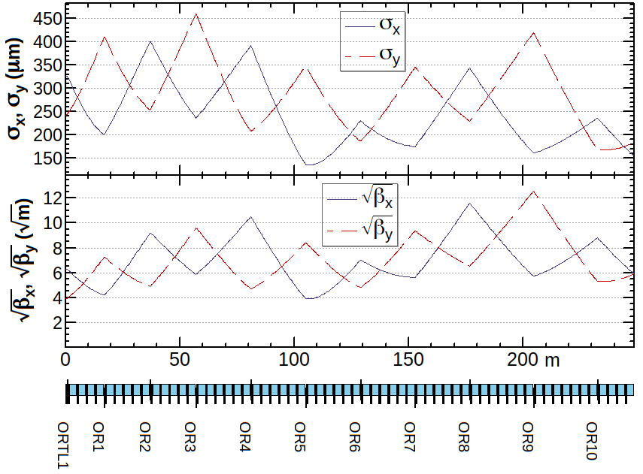
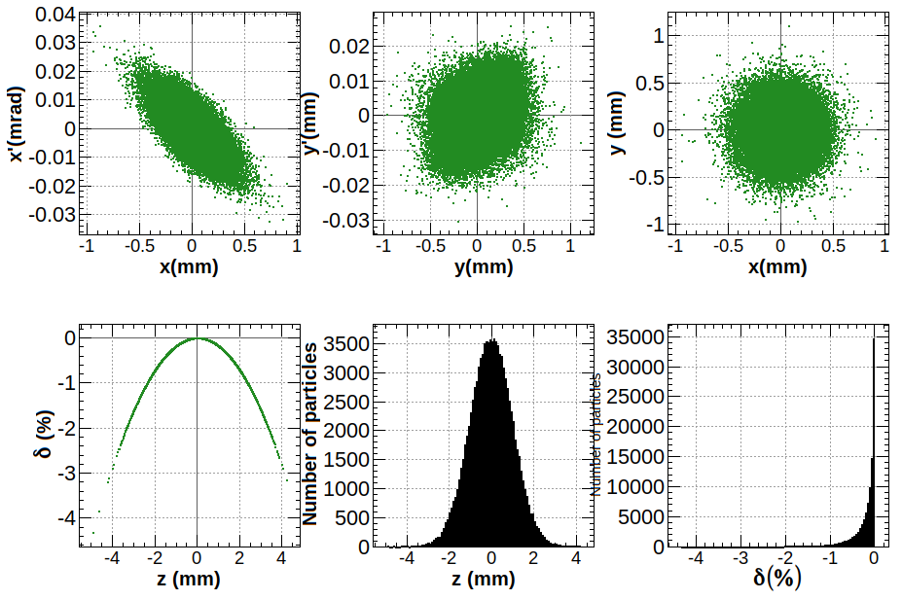
1.54 - 6GeV, no wakefield
αx = 0.912, αy = -0.499, βx = 35, βy = 35,
εx = 7e-10 (7.18e-10 )m, εy = 1e-9 (1.08e-10 ) m, σx = 156.52(158.74) um, σy =187.08 (192.21)um
E = 6.17GeV, δE = 0.25%, σz : 1mm

Slide 37
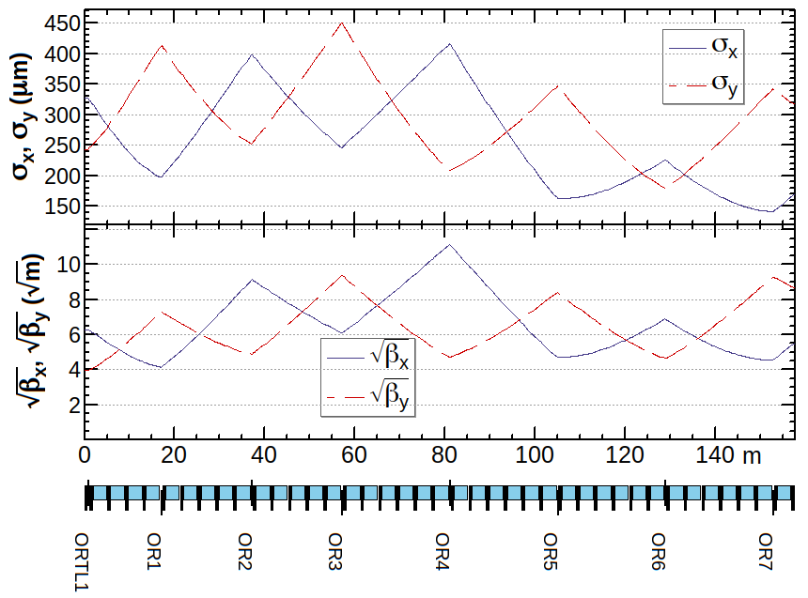
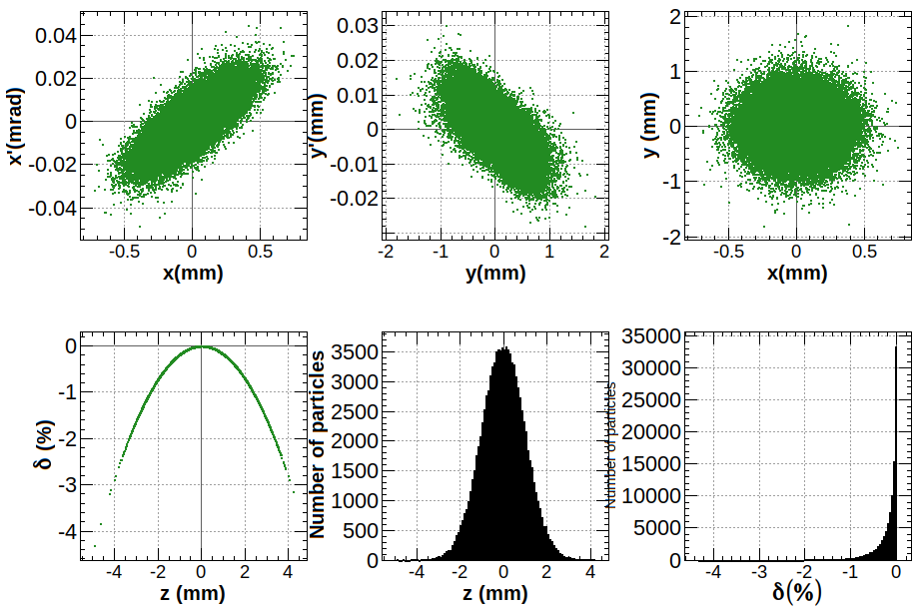
1.54 – 4.46GeV, no wakefield
αx = -1.21, αy = 1.09, βx = 30.75, βy = 75.00,
εx = 9e-10 (9.92e-10 )m, εy = 1.3e-9 (1.49e-9) m, σx = 166.36(173.44) um, σy =312.25(339.53)um
E = 4.467GeV, δE = 0.25%, σz : 1mm

Slide 38
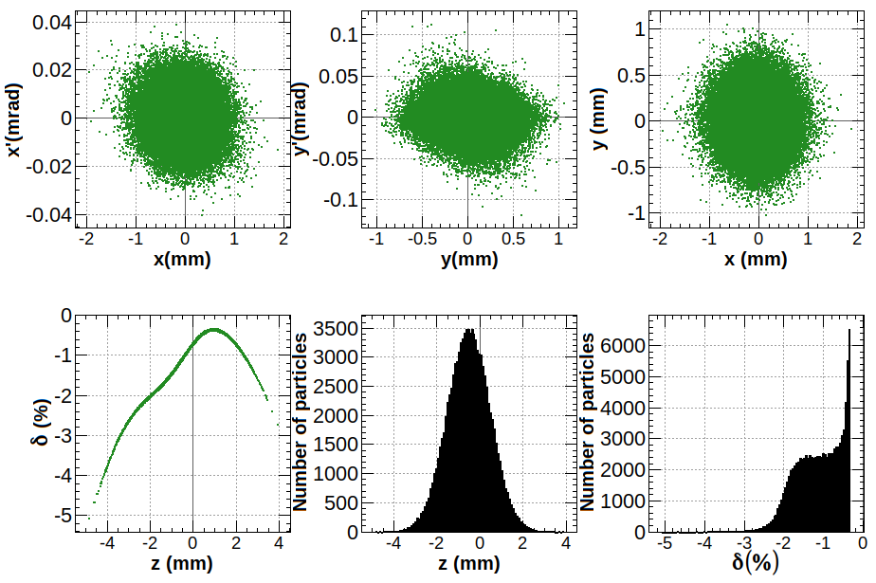
0 – 1.54GeV, with wakefield, without correction
αx = -2e-6, αy = 2e-6, βx = 39.52, βy = 15.56,
εx = 2.7e-9m (3.03e-9m), εy = 3.8e-9m (4.37e-9m), σx = 0.327 (0.35871)mm, σy = 0.243 (0.24769)mm
E = 1.571GeV, δE = 0.57%, σz : 1mm

Slide 39
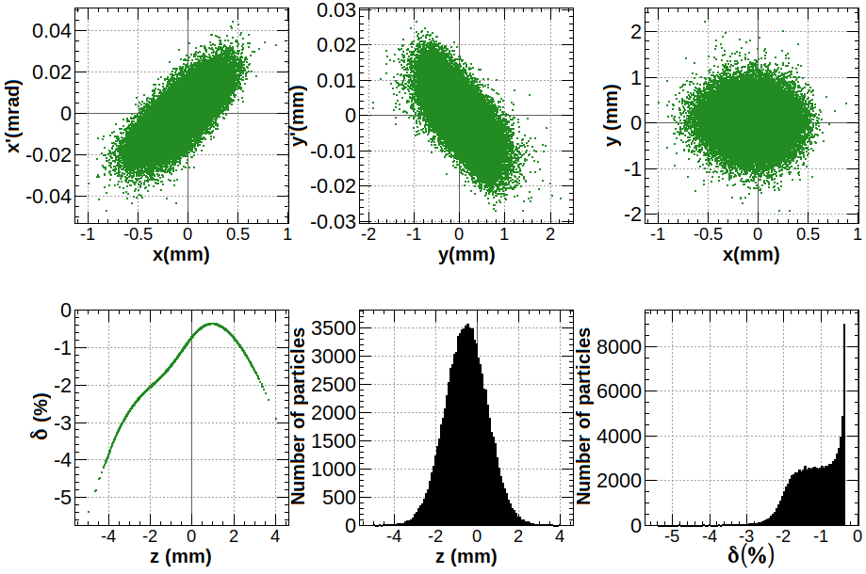
1.54 – 4.46GeV, with wakefield, without correction
αx = -1.21, αy = 1.09, βx = 30.75, βy = 75.00,
εx = 9e-10 (1.176e-9 )m, εy = 1.3e-9 (1.536e-9) m, σx = 166.36(194.95) um, σy =312.25(347.16)um
E = 4.467GeV, δE = 0.583%, σz : 1mm

Slide 40
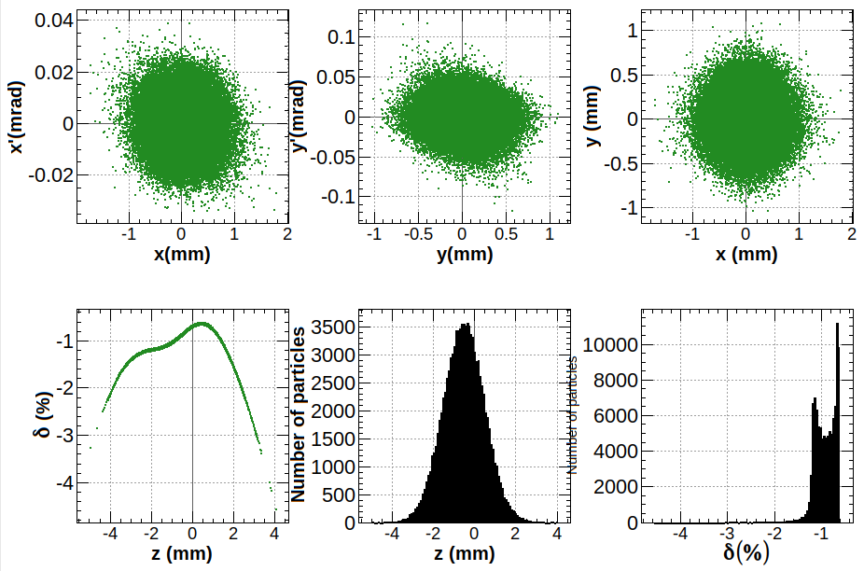
0 – 1.54GeV, with wakefield, with correction
Phase of cavity: -94°, δE : 0.57% → 0.227%,
εx : 3.03e-9m → 2.94e-9m, εy : 4.37e-9m → 4.35e-9m,
σx : 358.71um → 347.80um, σy : 247.69um → 244.11um

Slide 41
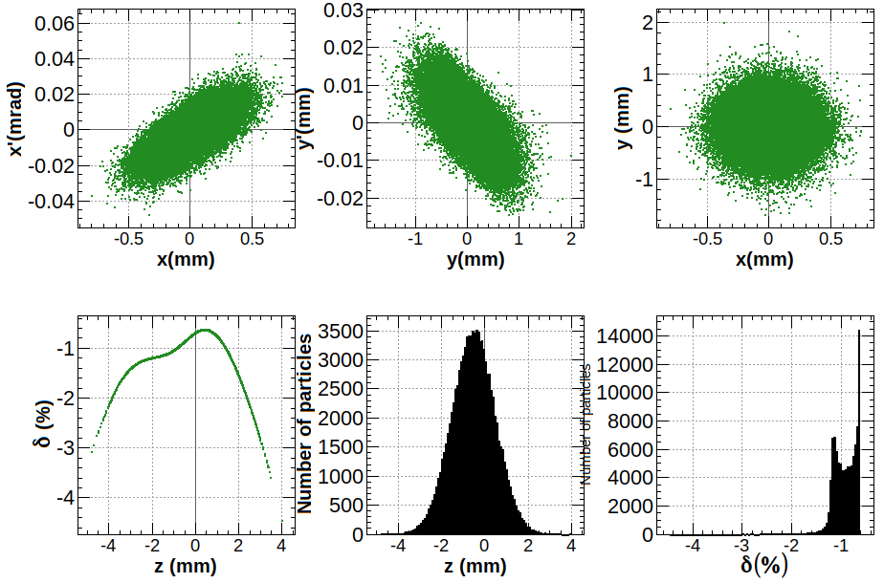
1.54 – 4.46GeV, with wakefield, with correction
Phase of cavity: -94°, δE : 0.58% → 0.23%,
εx : 1.176e-9m → 1.12e-9m, εy : 1.536e-9m → 1.523e-9m,
σx : 194.95um → 180.31um, σy : 347.16um → 345.31um
δE : 0.230%, αx = -1.21, αy = 1.09, βx=30.75, βy=75,
εx : 1.12e-9, εy : 1.52e-9,
σx : 180.31um, σy : 345.31um

